Slide 1

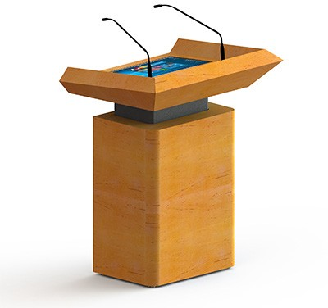
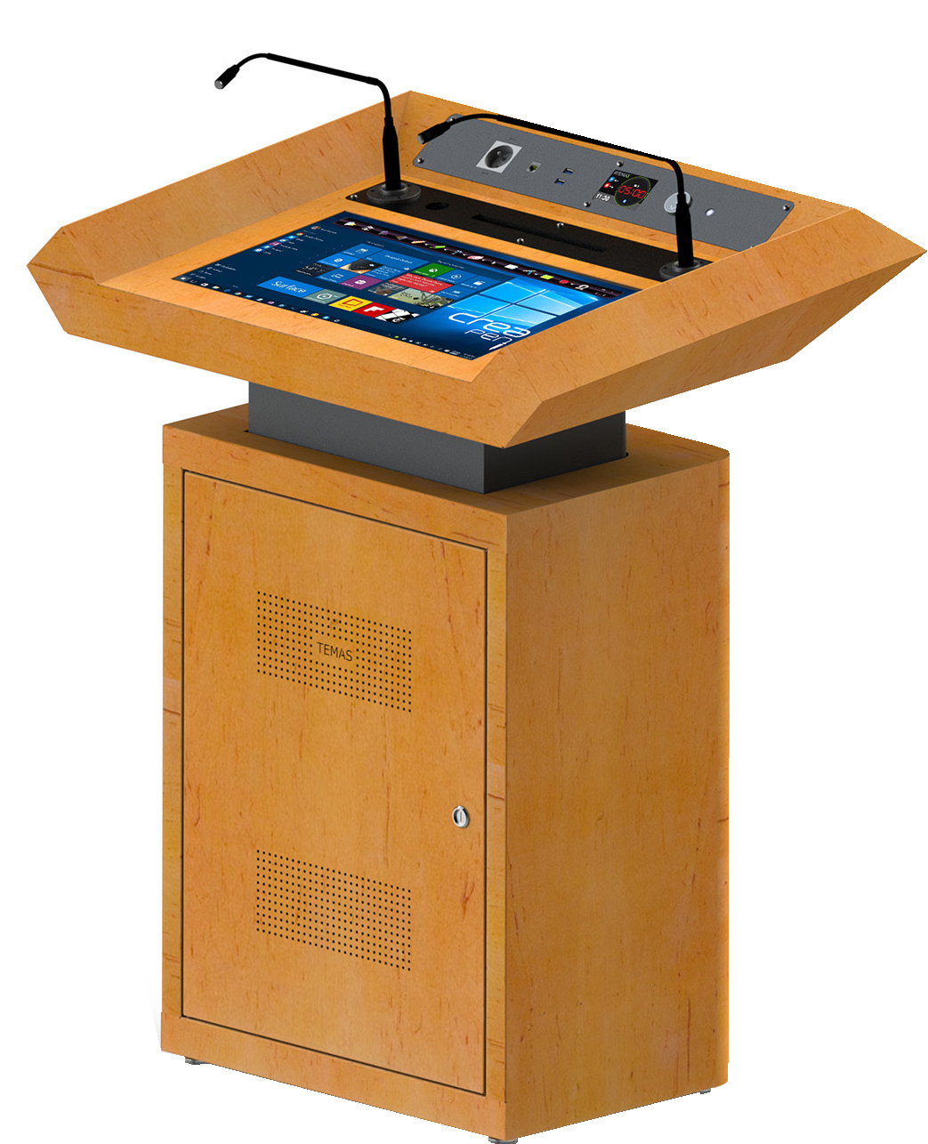

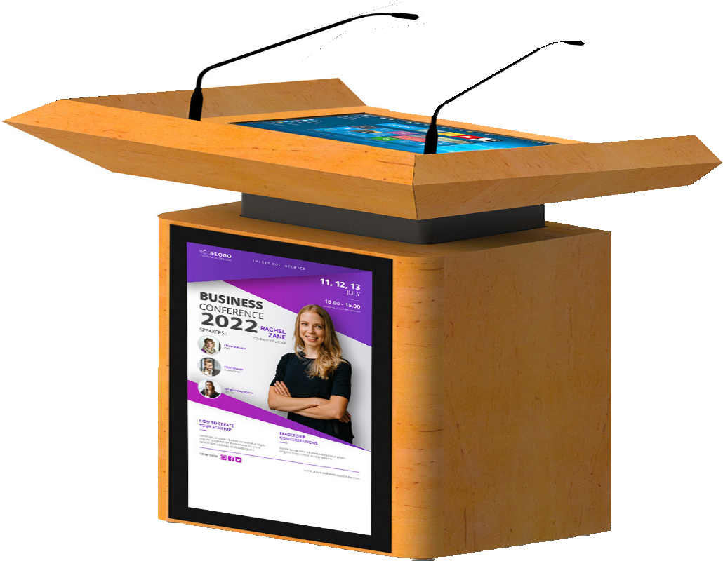
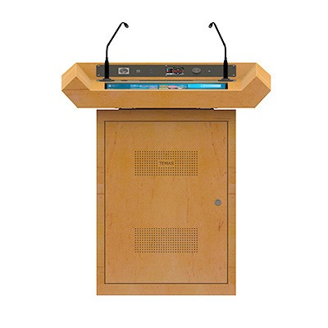
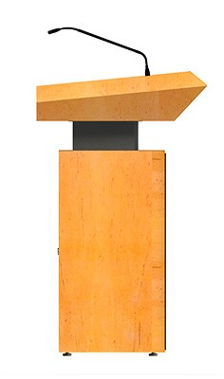
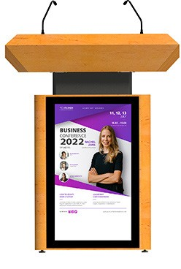

Slide 2







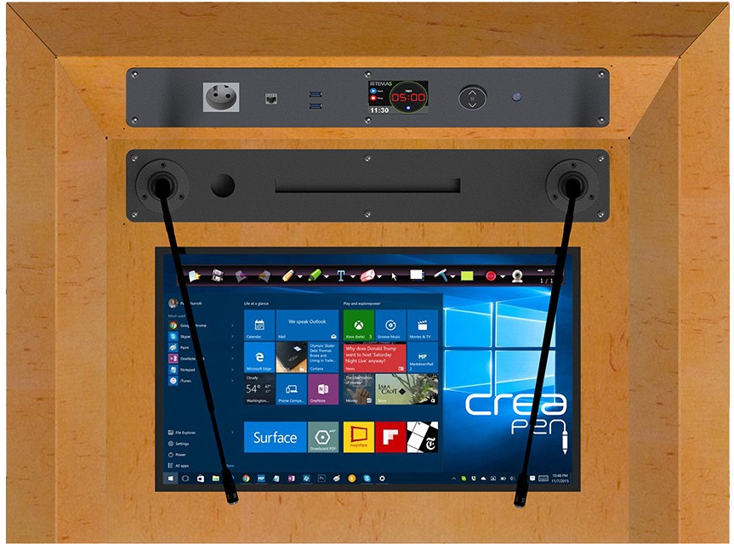






Connectivity
CONNECTIVITY ın
6
3 4 5
7
8
2
1
9
10
1 - 18”Shure Microphones 2 - Shock Mount
3 - Power 220V AC 4 - RJ43
5 - USB
- Clock & Timer
- Heigh Adjustment 8 - PC On/Off
- 22” Multi Touch Screen
- Creapen Annotation Software
TW23P is designed to satisfy the requirements in conference halls and hotels. Connecting projectors and audio systems to TW23P from its built-in connectors is easy. TW23P has latest technology for meeting rooms, and lecture halls. it is equipped with personels computer 32” front screen.
It is also designed to beused as an stand alone product
TW23P
 | TW23P | TW23P-A
Multi touch speaker screen | 22” | 22”
Front Screen with Embedded Signage Media Player | 32” | x
Electrical Lifting Column for Height Adjustment
Player PC : Intel i3 4GB, 120 SSD, Windows 10 Pro
Microphone
5” Digital Touch Timer
Creapen Annotation Software

Slide 3
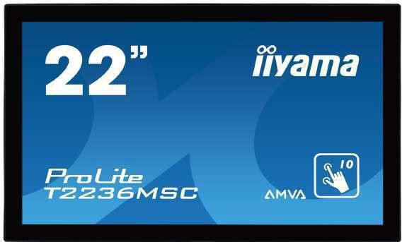
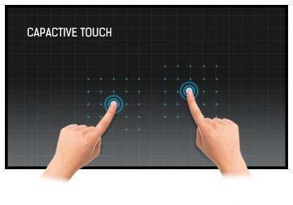
Speaker Screen
iiyama Prolite T22
22”
Prolite
22" 10 point touch monitor with edge-to-edge glass and AMVA panel
With its Full HD (1920x1080) resolution and accurate Projective Capacitive 10 point touch technology, the ProLite T22 delivers seamless and accurate touch response.
The AMVA panel technology guarantees high performance with excellent colour reproduction and high contrast, making it an excellent choice for a vast array of demanding interactive applications.
Touch Technology
This technology uses a sensor-grid of micro-fine wires integrated into the glass that covers the screen. Touch is detected because electrical characteristics of the sensor grid change when human finger is placed on the glass. Thanks to the glass overlay this technology is highly durable, and the touch function remains
latex gloved) and stylus-pen.
Specifications Diagonal | 21.5"; 55cm
Aspect Ratio | 16 : 9
Panel Amva | LED
Native Resolution | Full HD 1080p, 1920 x 1080 ( 2.1 megapixel)
Brightness
Brightness
Advanced Contrast | 12 000 000 : 1 ACR
Static Contrast | 3 000 : 1 with touch panel
Response Time | 8 ms
Viewing Zone | horizontal/vertical: 178°/ 178°; right/left: 89°/ 89°; up/down: 89°/ 89°
Display Colour | 16.7 million
Blue Light Reducer | yes
Touch Technology | projective capacitive
Touch Points | 10
Glass Hardness | 7H minimum
Light Transmittance | 85%
Display Area | H X W 268.1 x 476.6 mm; 10.6" x 18.8 "
Pixel Pitch | H X V 0.248 x 0.248 mm
Horizontal Sync | 30 - 80 KHz
Vertical Sync | 56 - 75 Hz
Synchronization | Separate Sync
INTERFACES / CONNECTORS / CONTROLLERS
Analog Input Connector | VGA
Digital Input Connector | DVI, HDMI
USB HUB | UP 1 x USB 3.0 / DOWN 4 x USB 3.0
Controls | USB (touch), USB 3.0

Slide 4
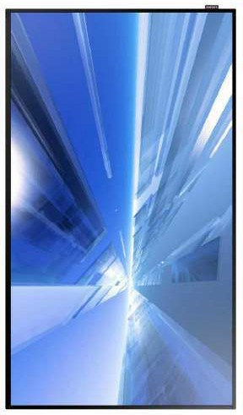


Front Screen
32
”
Conveniently and simply manage a rich array of content with an advanced platform
whenever and wherever they are most impactful.
And, with high 400 nit brightness and crystal clear image quality, your on the podium information are sure to captivate viewers. The unique Picture Quality Enhancer function optimizes the color, detail, contrast and color temperature for your environment with rich color and detailed textures. Viewing is maximized by eliminating factors that can interrupt visibility from light reflection, and reducing glare and haze to only 2%. Plus, connectivity options are enhanced with two HDMI ports for easier enriched content display.
Durable and extended 24/7 usage for continuous high performance with clear visibility
All-in-one display solution with embedded Media Player, no need for external media players
Simplified content management with built-in Wifi and an easy-to-use mobile application
Specifications Diagonal Size | 32”
Type | 60Hz D-LED BLU
Resolution | 1920*1080 (Full HD)
Pixel Pitch(mm) | 0.12125(H) x 0.36375(V)
Active Display Area(mm) | 698.4(H) x 392.85(V)
Brightness(Typ.) | 400 nit
Contrast Ratio | 5000:1
Viewing Angle(H/V) | 178:178
Response Time(G-to-G) | 8ms
Display Colors | 10bit Dithering - 1.07Billion
Color Gamut | 0.72
Operation Hour | 24/7
Haze | 2%
Dynamic C/R | 50,000:1
H-Scanning Frequency | 30 ~ 81kHZ
V-Scanning Frequency | 48 ~ 75HZ
Maximum Pixel Frequency | 148.5MHz
Speaker Type | Built in Speaker(10W x 1)

Slide 5
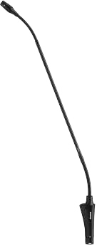

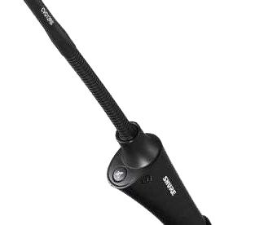

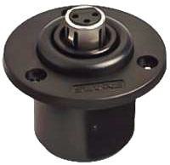
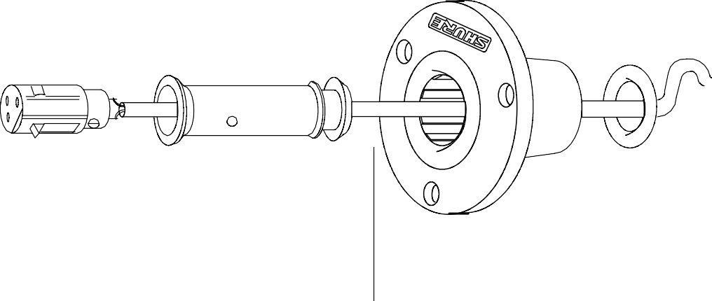
Microphone
Shure 18 CVG18S-B Microphone
Designed with dual gooseneck sections for full articulation, the CVG18 provide scalable, best-in-class performance in a wide variety of locations.
Features
Cardioid polar pattern with tailored response for speech
Dual-section gooseneck enables ease of positioning and placement options
Included Flange Mount and available snap-fit windscreens (ACVG4WS-B – 4 pack)
With Mute switch/LED,
Guards against unwanted RF Interference from portable wireless devices gh resistance to intense nearby radio signals
Superior Shure design and rugged, dependable construction
Noise by up to 20 dB.
Specifications
Cartridge Type Electret Condenser
Frequency Response
Electret Condenser
Polar Pattern
70–16000 Hz
Output Impedance
Cardioid
Sensitivity (at 1 kHz , open circuit voltage)
180 Ω
Maximum SPL (1 kHz at 1% THD)
–33 dBV/Pa[1] (22 mV)
Signal to Noise Ratio (referenced at 94 dB SPL)
120 dB SPL
Dynamic Range
67 dB
Self Noise (equivalent SPL, A-weighted, typical)
93 dB
Common Mode Rejection (10 Hz to 100 kHz)
27 dB SPL
Preamplifier Output Clipping Level (1% THD)
45 dB
Polarity
−7 dBV
Power Requirements
3
11–52 V DC[4], 2.0 mA
Shure A400SMXLR Shock Mount
Shure A400SMXLR Shock Mount Socket
A400SMXLR Shock Mount decouples a microphone from the mounting surface and reduces transmission of impact or surface
Connector
Insert
Cable Shock Mount
Rubber Grommet

Slide 6
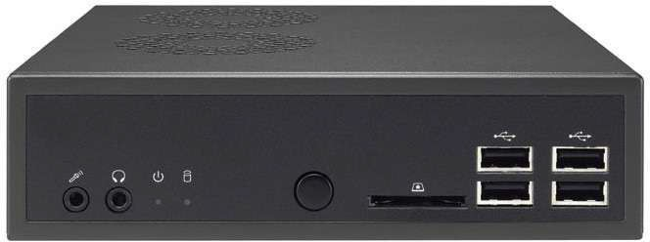
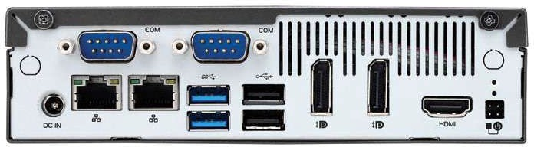

PC
Player PC
Specifications Operatıng System
Processor
Windows 10 Pro
Chıpset
Intel Core i3
Ram
Intel H310 Express chipset
Vıdeo
4GB
Storage
HDMI x1 + DisplayPort x1 Supported double screens , 4K Play
Audıo
120 GB SSD
Network
2 Channels
Ports
2 x 10/100/1000 Gigabit LAN (Intel Chipset), WIFI (Optional)
Case
4 x USB3.0 - 2 x USB2.0 - 1 x HDMI - 1 x Display Port - 1 x eSATA+USB2.0 COM port 2 x RJ45
Power
Ultra Mini ITX
90W 19V Adapter

Slide 7
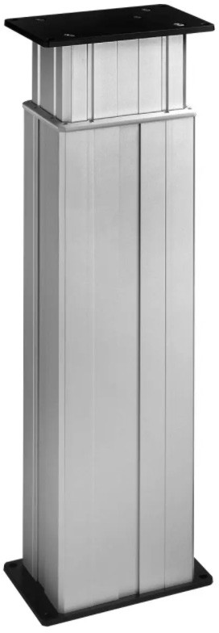
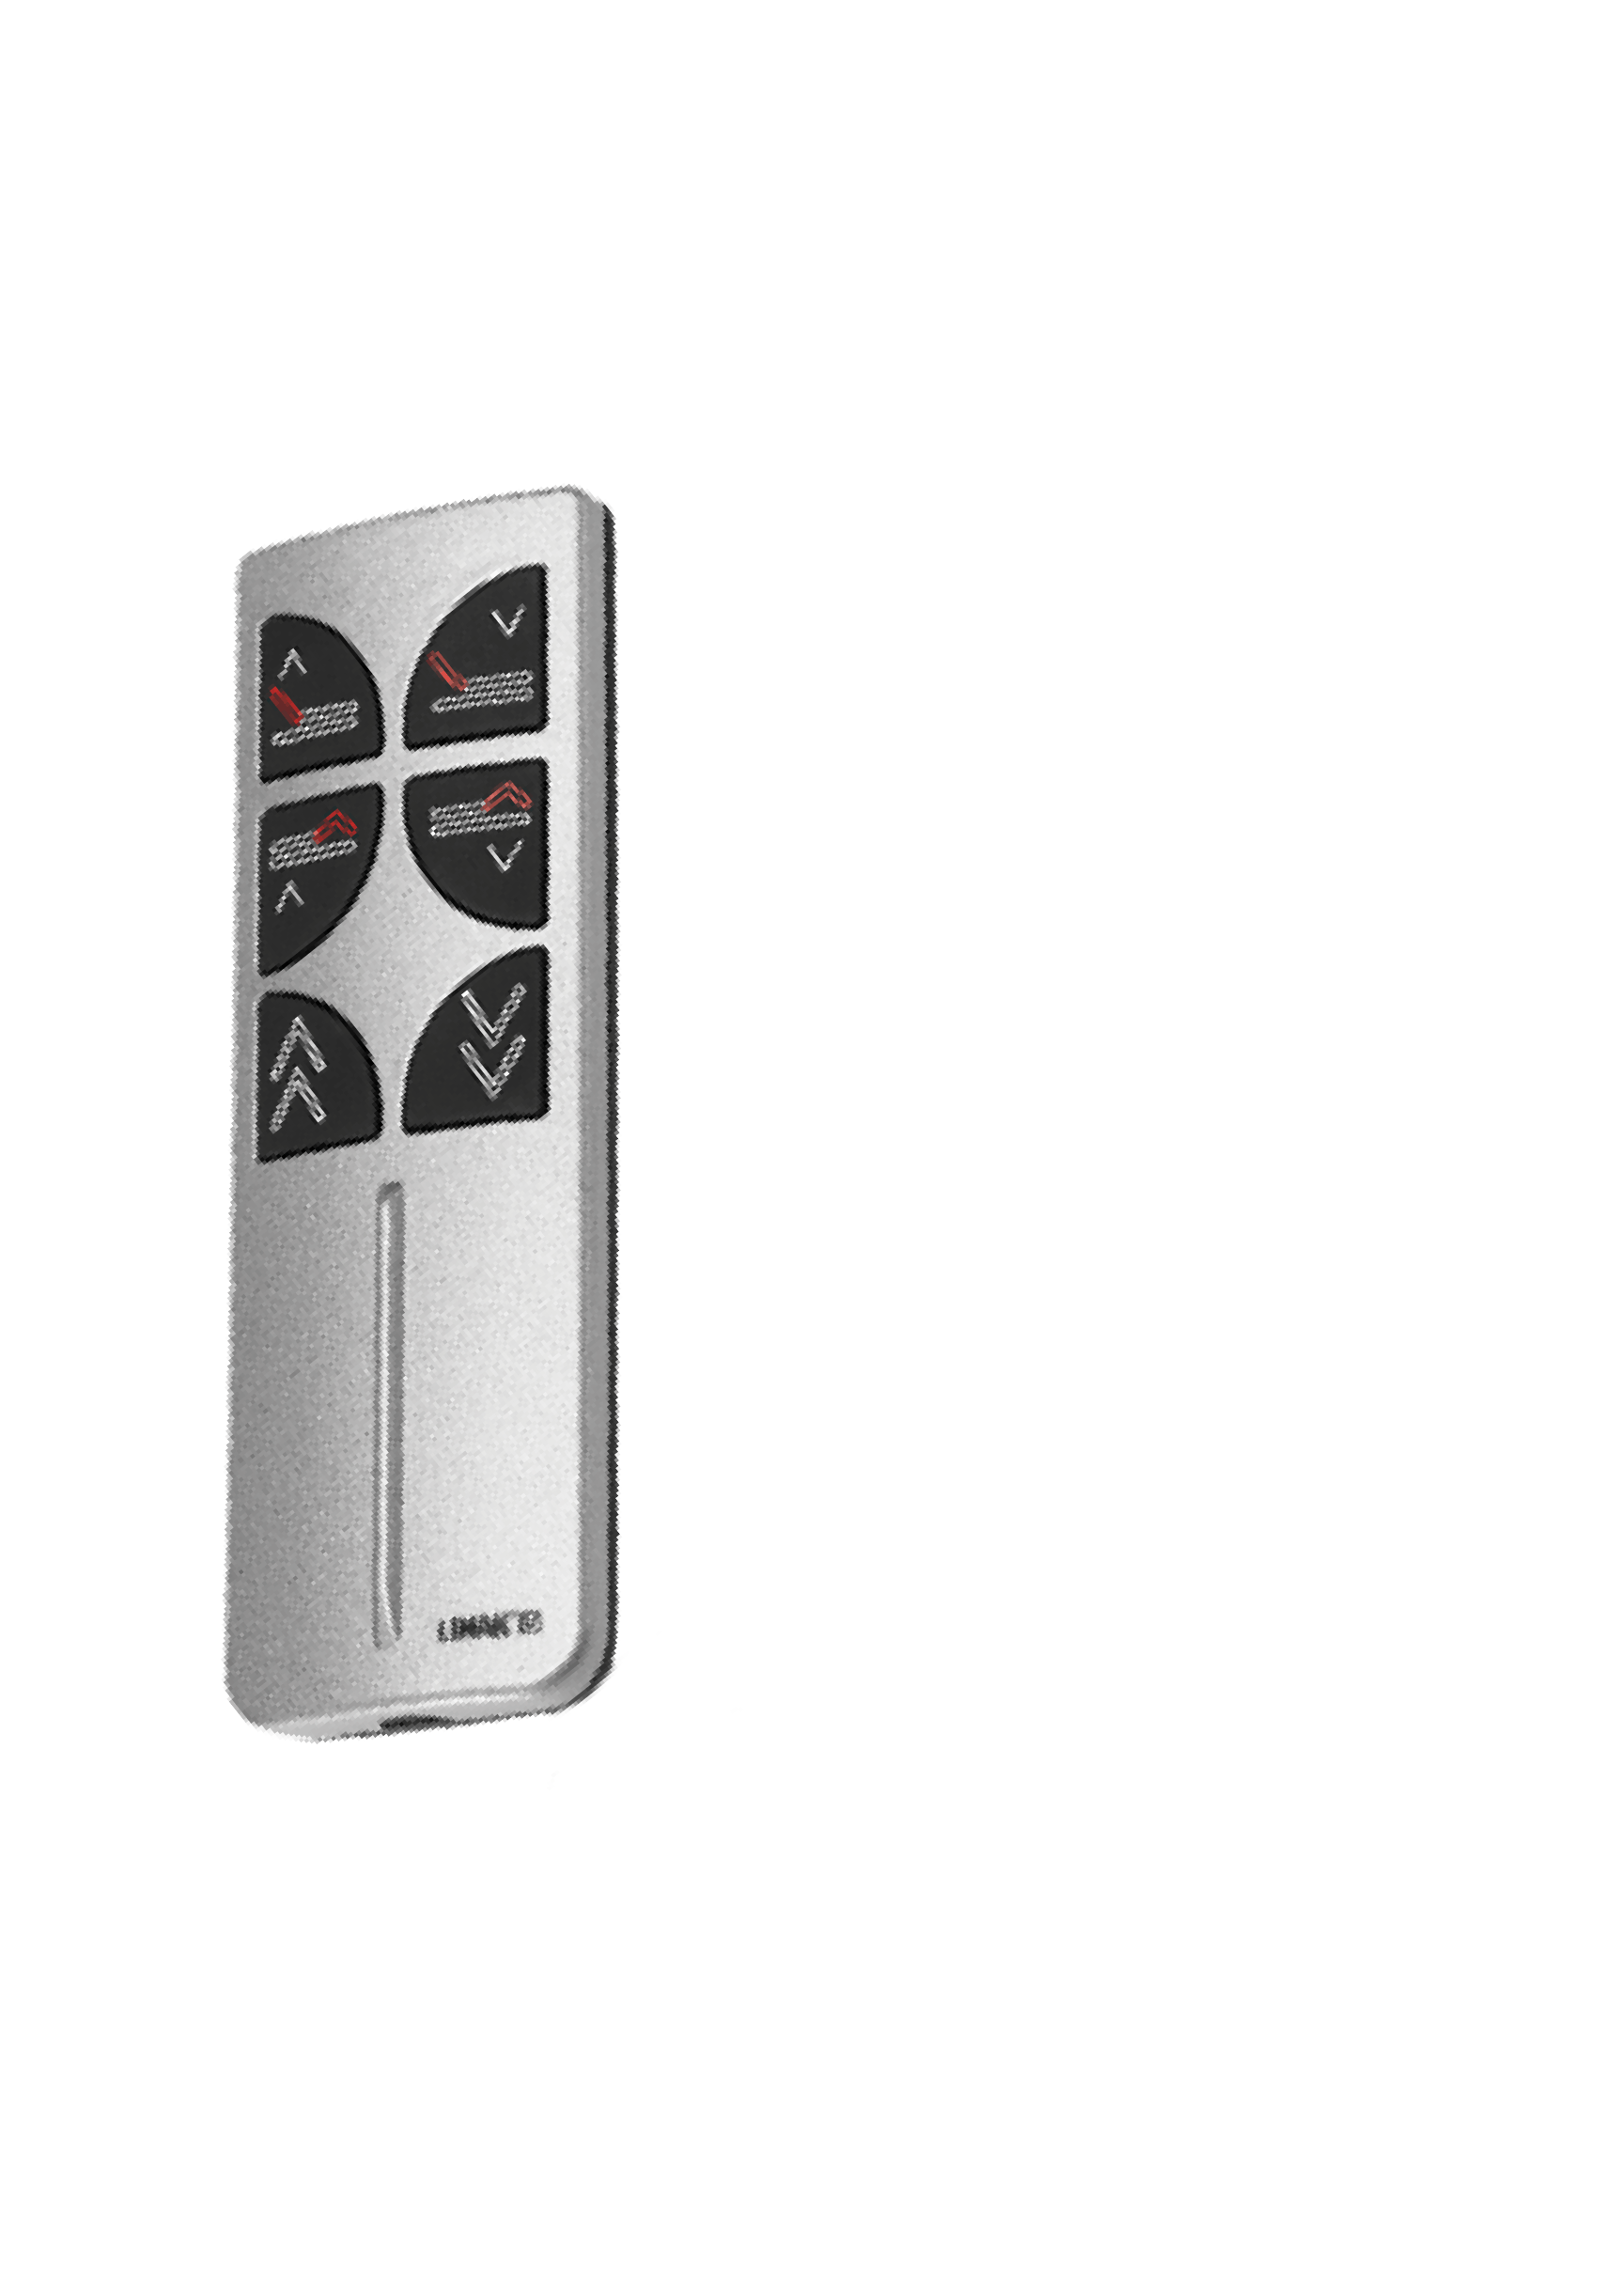
Height Adjustment
Linak DL2 Lifting Column
The hallmarks of the DL2 are the 3-stage inline design meaning that the motor is hidden inside the profiles giving the column a very sleek and elegant design easy to integrate in various desk designs. The 3-stage construction ensures a very low built-in dimension meaning that people of all heights can use the desk. The very low noise level ensures pleasant use when driving.
Max. thrust 700 N per column
Max speed: 38 mm/s unloaded
Bending moment: Max. 150 Nm dynamic
Low and uniform noise level
PVC-free column
Specifications
Single or 2, 3, 4 parallel drive
Multi-parallel is possible only when in combination with CBD6S
Duty cycle: 10% ~ 2 minutes of continuous use at full load, followed by 18 minutes of pause Ambient temperature: +5° to +40°C
Remote Control
The Hand Control HB10 wireless is designed for control podium remotely The HB10 wireless combines ergonomic design and functionality into a user-friendly hand control with big
intuitive buttons and without any annoying cable.
Hand control controlling 2 channels
Easily operated by both left and right-handed persons
Colour on top part is silver (RAL 7035) and the bottom part is a soft black rubber coating
Simultaneous drive up and down
Transmitter signal based on 433 MHz or Bluetooth® connection
Long-life batteries included. Battery lifetime at normal use of 1 minute per day is about 10 years

Slide 8
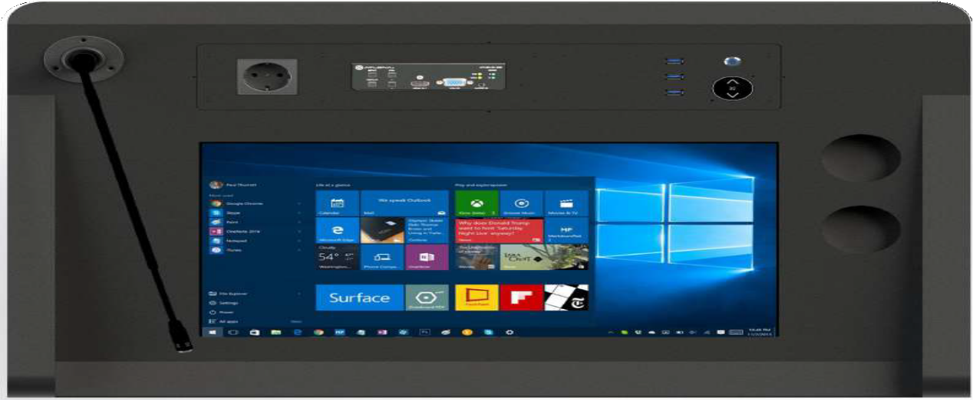
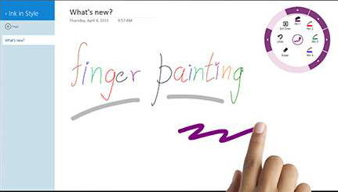



Application
Creapen Software
Screen Annotation & Screen Recording Solution for Presentations
CreaPen is an extremely simple yet powerful screen annotation and recording software. You can easily write on top of any other application that is currently active on the desktop, even on a running video. You can then save your annotations as an image file or even record the whole session as a video for sharing. It is a useful took for presenters to communicate and share idead during a live session, for educators to create e[Xective video tutorials and for salespeople to create impressive video presentations.

Slide 9
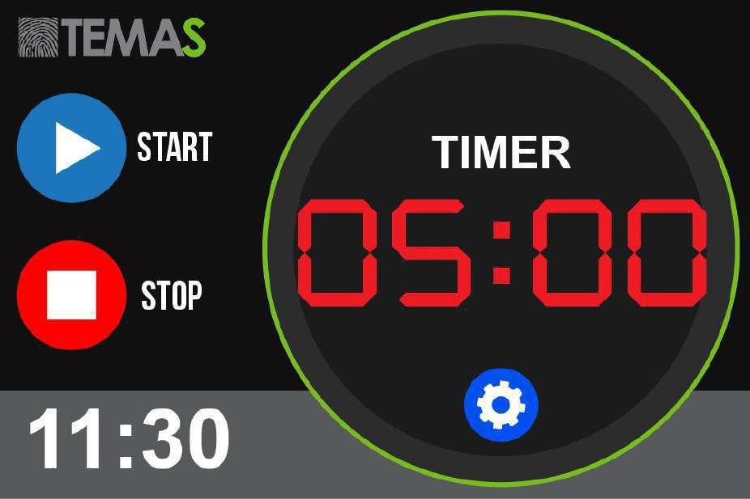
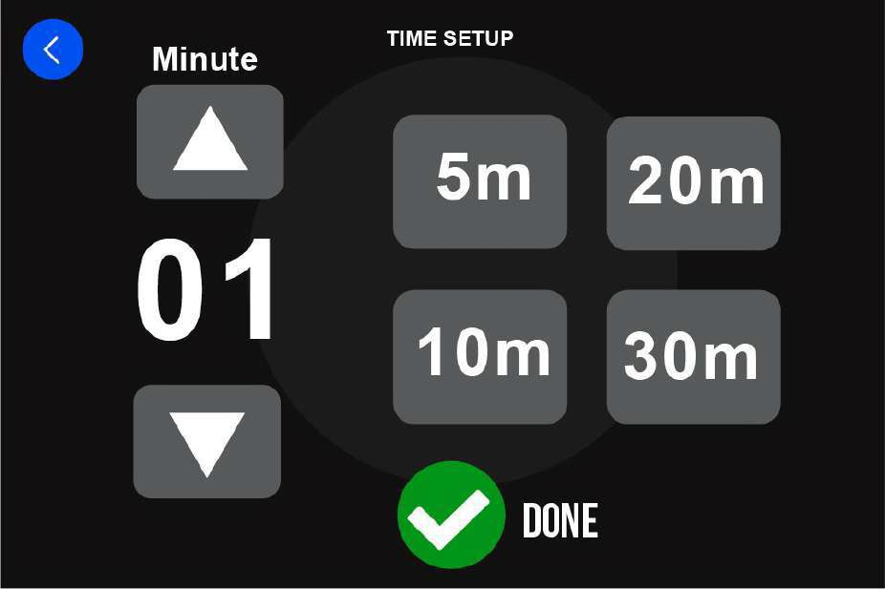
Application
5” Touch screen Timer & Clock

Slide 10
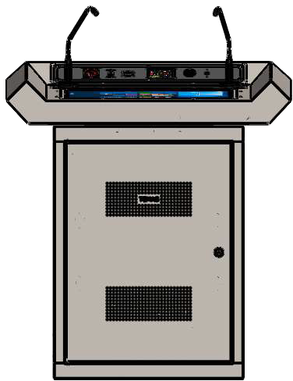
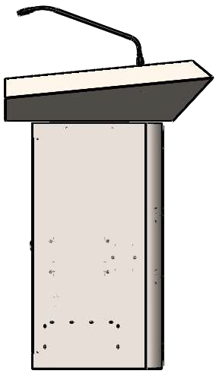
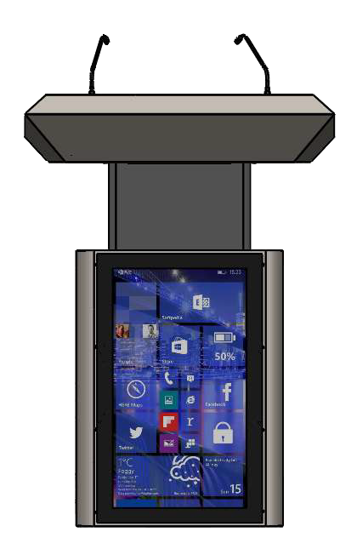
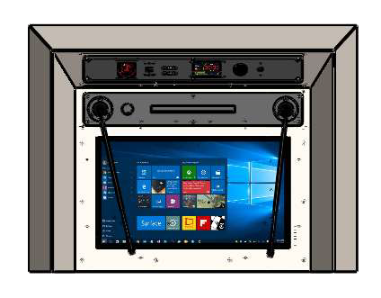
MECHANICAL SPECIFICATIONS
900
675
800
600
420
900
1251
675

Slide 11
Technical specifications
Front Panel | TW23P 32” |  | TW23P-A -
Resolution | 1920x1080 FHD |  | -
Brightness | 350 cd/m2 |  | -
Aspect Ratio | 16:9 |  | -
Panel Type | IPS |  | -
Front Panel Player | Digital Signage Media Player |  | -
Lecturer Panel | 22” |  | 22”
Screen
Resolution | 1920x1080 |  | 1920x1080
Brightness | 250 cd/m2 |  | 250 cd/m2
Aspect Ratio | 16:9 |  | 16:9
Number of Touch Point | 10 Points Capacitive |  | 10 Points Capacitive
Lecturer Panel PC
CPU | Intel i3 |  | Intel i3
RAM | 4 GB DDR4 |  | 4 GB DDR4
HDD | 120 GB SSDE |  | 120 GB SSDE
Operation System | Windows 10 Pro |  | Windows 10 Pro
Microphone
Lenght | 18” |  | 18”
No of Microphone | 2 pcs |  | 2 pcs
Output Connector | 3-way XLR(Male) |  | 3-way XLR(Male)
Mıcrophone Type | Cardioid |  | Cardioid
Frequency Response | 50 - 18 kHz |  | 50 - 18 kHz
Power ON Indicator | LED |  | LED
Power Requirement | Phantom Power (48V) |  | Phantom Power (48V)
Outputs (Bottom of Podium)
HDMI | Available (Projector Out) |  | Available (Projector Out)
Ethernet | Network Connection |  | Network Connection
XLR for Microphone | 3-way XLR(Male) |  | 3-way XLR(Male)
USB | USB 2.0 (for internal PC) |  | USB 2.0 (for internal PC)
Electrical Lifting Column for Height Ad
 | justment
Movement | Vertical (Up/Down)
Control | By Buttons (Up/Down) and Remote Control
Speed | Max speed: 38 mm/s
Lifting Strength | 700N
Locking System | Automatic Looking when engine not working
Engine Type | Electrical
Mechanical Specs
Outline Dimesion(mm)Set | 689 x 850 x 1159 | 689 x 850 x 1159
Outlibe Dimension(mm)Package | 820 x 990 x 1390 | 820 x 990 x 1390
Weight(kg) | Set: 73 kg Package: 129 kg | Set: 73 kg Package: 129 kg

